Slide 1

Digital TA Specialist
November 2024
Case Study Panel:
Sanne Rorby, Head of Functional Delivery
Zita Szenci-Szabó, Regional Recruitment Solution Lead, Europe&SAMEA
Csaba Greguss, Global Executive and Strategic Talent Sourcing Lead

Slide 2
Savitha Kandugula
Senior Talent Acquisition Specialist
💼 Professional Experience:
"With over 6 years of diverse recruitment experience spanning industries like chemical manufacturing, IT, and digital marketing, I bring a well-rounded perspective to talent acquisition. Currently, as an IT Recruitment Partner at Elevate Jobs, I increased placement rates by 20% through strategic sourcing, even with limited resources."
🔍 Why I am a Sourcing Expert:
"I am relentless in finding solutions. For every recruitment challenge, I believe there’s a way to succeed with enough time, effort, and a creative approach."
📊 How I Use Data in My Everyday Life:
Professionally: "In my current role, I began with no established database. Over two months, I experimented with different sourcing methods, analyzing each to discover the most effective channels for results."
Personally: "I apply the same analytical approach in daily life, like recently researching the best deal on a perfume across multiple sites before buying."
💡 What Makes Me Unique:
"My curiosity drives me to learn, adapt, and explore innovative solutions continuously. This quality keeps me engaged and enables me to bring fresh ideas and adaptability to every role."

Slide 3
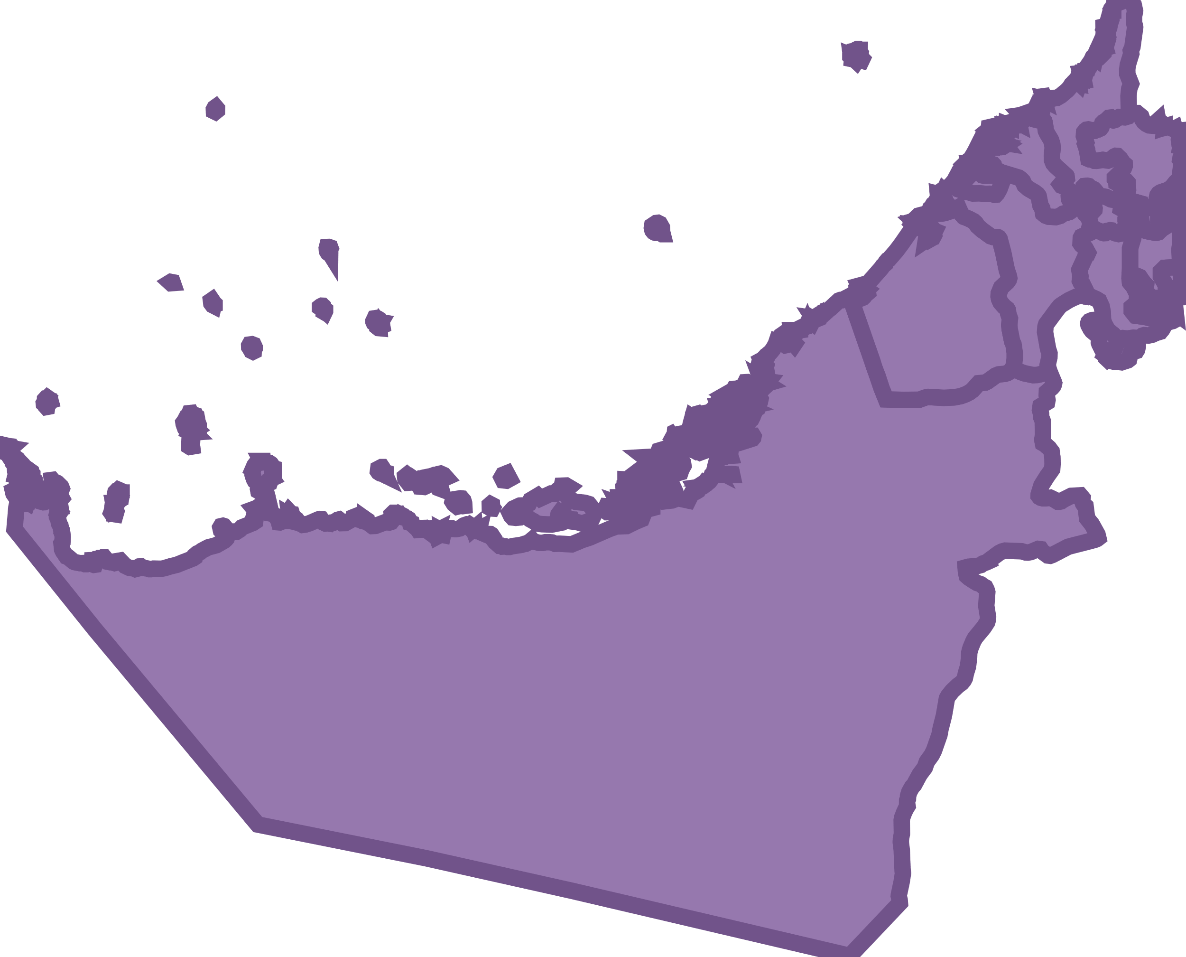
Background
Tunisia
Morocco
Egypt
Saudi Arabia
UAE
Primary Locations
Dubai (UAE).
Casablanca(Morocco).
Cairo (Egypt)
Secondary Locations
Abu Dhabi (UAE)
Sharjah (UAE)
Riyadh (Saudi Arabia)
Tunis (Tunisia)

Slide 4
Primary Locations
Casablanca
Cairo
Dubai
Dubai (UAE)
💼 Both business lines.
Key Recruitment Considerations:
📈 High Talent density. (Luxury and CPG)
🌐 English Primary, Arabic, Hindi, Urdu
🪪 Structured Visa; Golden Visa
🩺 Mandatory
🧾 Possible corporate tax but no PIT
🧑🏻‍🤝‍🧑🏻 Emiratisation
🧑🏻‍💻 Flexibility
🔍 LinkedIn, Bayt, Naukrigulf
Analysing Talent Pool:
🧑🏽‍💼 Seniority: Midlevel Candidates
🧑🏾‍🤝‍🧑🏻 Diversity: Up to 40% KAM are expatriate and mostly male dominance in senior roles but efforts to increase female %
Casablanca (Morocco)
💼 Both Business Lines
Key Recruitment Considerations:
📈 Bilingual Talent Pool Ideal for NA Market
🌐 French, Arabic dominant, English
🪪 Work permit & RP needed
🩺 Mandatory
🧾 IT 38%, SS by employer 25% and by employee 7%
🧑🏻‍🤝‍🧑🏻 Top priority to local talent
🧑🏻‍💻 44 hours over 6 days a week
🔍 LinkedIn, Bayt, Naukrigulf, and other.
Analysing Talent Pool: 🧑🏽‍💼 Seniority: Junior to Mid-Level
🧑🏾‍🤝‍🧑🏻 Diversity: More women in managerial roles compared to UAE. Majority is locals with small % of expats from France.
Cairo (Egypt)
💼 Taste and wellbeing, cost effective – Food science & CPG sector
Key Recruitment Considerations:
🌐 Arabic & English
🪪 WP and RP needed
🧾 IT 25%, SS by employer 26% & employee 14%
🩺 Mandatory
🧑🏻‍🤝‍🧑🏻 90% must be locals
🧑🏻‍💻 48 hours work over 6 days
🔍 LinkedIn, Bayt, local channels
Analysing Talent Pool: 🧑🏽‍💼 Seniority: all levels
🧑🏾‍🤝‍🧑🏻 Diversity: limited expats in KAM roles
Women are preferred In senior roles.

Slide 5
Secondary Locations
Tunis
Riyadh
Sharjah
Abu Dhabi
Riyadh (Saudi Arabia)
💼 Both Business Lines
Key Recruitment Considerations:
🌐 Arabic primary but English essential
🪪 IQAMA work permit
🩺 Mandatory
🧾 Corporate Tax but PIT
🧑🏻‍🤝‍🧑🏻 Saudization (Nitaqat) requires certain quotas to hire Saudi nationals
🧑🏻‍💻 Sunday to Thursday – remote work less likely
🔍 LinkedIn, GulfTalent, etc..
Analysing Talent Pool:
🧑🏽‍💼 Seniority: more junior to midlevel
🧑🏾‍🤝‍🧑🏻 Diversity: strategic growth in female participation
Diverse but more preference to Locals
Abu Dhabi (UAE)
💼 Cost efficient alt within UAE for Taste and wellbeing
Key Recruitment Considerations:
🌐 English primary but Arabic, Hindi, Urdu
🪪 Structure visa (Golden visa)
🧾 Corporate tax but there is PIT
🩺 Mandatory
🧑🏻‍🤝‍🧑🏻 Emiratisation
🧑🏻‍💻 Flexible
🔍 LinkedIn, Bayt, Naukrigulf and other
Analysing Talent Pool:
🧑🏽‍💼 Seniority: mostly Junior level but also some mid-level
🧑🏾‍🤝‍🧑🏻 Diversity: - tight market for Sr positions
Male dominance, but efforts to improve female participation.
Sharjah (UAE)
💼 Lower cost option in UAE for Fragrance & Beauty with proximity to Dubai
Key Recruitment Considerations:
🌐 Arabic (Dominant) and English.
🪪 Golden visa
🩺 Mandatory
🧾 No personal tax but corporate tax
🧑🏻‍🤝‍🧑🏻 Emiratization
🧑🏻‍💻 Flexible
🔍 LinkedIn, Bayt, Naukrigulf and others
Analysing Talent Pool:
🧑🏽‍💼 Seniority: Mix of balanced levels, more focus on Junior levels.
🧑🏾‍🤝‍🧑🏻 Diversity: Data is limited but seems like there are process to improve Female participation.
Tunis(Tunisia)
💼 Affordable, Multilingual talent for NA in Fragrance and Beauty
Key Recruitment Considerations:
🌐 French (High), Arabic and limited English
🪪 Obtained up on arrival
🩺 Mandatory
🧾 IT 35%, SS by employer 16.57% and employee 9.18%
🧑🏻‍🤝‍🧑🏻 Need proof of no locals to obtain foreign nationals
🧑🏻‍💻 48 hours over 6 days a week
🔍 LinkedIn, Bayt, local job boards.
Analysing Talent Pool:
🧑🏽‍💼 Seniority: Junior & Mid-level roles
🧑🏾‍🤝‍🧑🏻 Diversity: Female % is higher 25% but with KAM relatively low

Slide 6
Talent Pool Analysis

Slide 7
Diversity and Localization Insights by Region
Location | Expat VS Local Talent | Gender Diversity (Male/Female) | Localization Policies | Key Insights
Abu Dhabi | Majority locals, some expats | Primarily male-dominated, improving female participation | Emiratization | Cost-effective alternative within UAE; junior to mid-level roles ideal for local talent
Dubai | 40% Expatriates, 60% Locals | Predominantly male in senior roles, efforts to increase female representation | Emiratization | High expatriate population; strategic for senior roles; localization policy impacts expatriate hiring
Egypt | 90% Locals, 10% Expats | Balanced gender diversity, particularly in senior roles | N/A | Diverse talent pool; cost-effective; suitable for volume hiring and gender-diverse roles
Morocco | Mostly locals, small % expats (from France) | High female representation in managerial roles | N/A | Bilingual talent (French & Arabic); aligns well with diversity goals
Riyadh | Preference for locals | Increasing female workforce participation | Saudization (Nitaqat quota system) | Local talent focus due to Saudization; growth in female representation but primarily male-dominated
Sharjah | Smaller expat population | Limited data, increasing female participation | Emiratization | Lower-cost option within UAE, especially for junior roles; good for regional support roles
Tunisia | Primarily locals | Higher female representation in junior roles | Requires proof of no local talent for expat hires | Cost-effective for entry-level roles; strong female representation in Fragrance & Beauty sector

Slide 8
Recommendations
Diversity and Localization: Align Dubai and Riyadh recruitment with local policies and promote female representation where feasible.
Secondary Support Hubs: Utilize Abu Dhabi, Sharjah, and Tunisia for entry-level roles, providing cost-effective solutions while maintaining access to talent with the desired language and cultural alignment.
Primary Focus: Prioritize Egypt, Morocco, and Dubai for strategic hiring across seniority levels, leveraging their high talent density and diversity support.

Slide 9
Thank You!

